Slide 1

AidsBridge
Presented by team helikopter

Slide 2
Team Members
Github Link | https://github.com/info-6150-spring-2024/final-project-teamhelikopter.git
Name: | Northeastern University email:
Zenan Fan | fan.zen@northeastern.edu
Yinhao Zhao | zhao.yinh@northeastern.edu
Ting Guo | guo.ting1@northeastern.edu
Zuyi Huang | huang.zu@northeastern.edu

Slide 3

TABLE OF CONTENTS
01
02
03
04
05
06
Overview
Features
DDD Model
Project Details
Showcase
Conclusion

Slide 4


01
Overview

Slide 5
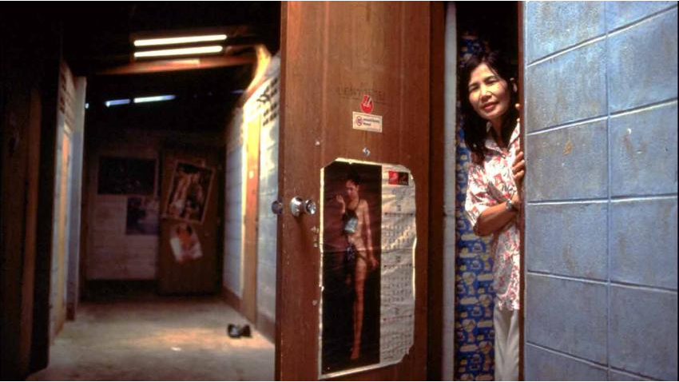

Overview
Background:
HIV infections have been reduced by 59% since the peak in 1995, (by 58% among children since 2010) and AIDS-related deaths have fallen by 69% since the peak in 2004 and by 51% since 2010. Globally 46% of all new HIV infections were among women and girls in 2022. The UN family has been in the vanguard of this progress.

Slide 6
OBJECTIVES
Our aim
The goal
AIDSBridge aims to leverage digital technology to enhance awareness, education, and support for individuals impacted by HIV/AIDS globally. By creating a centralized platform, our project seeks to break down informational barriers and foster a community that can access up-to-date resources, expert advice, and peer support. The initiative aligns with the United Nations' goal to end the AIDS epidemic as a public health threat by 2030, focusing on expanding access to prevention, treatment, and care.
Educates the public about HIV/AIDS prevention and management through reliable, easily accessible information.
Connects individuals living with HIV/AIDS, healthcare providers, and support groups in a supportive online community.
Facilitates the sharing of the latest research, treatment options, and stories from around the world to empower users and inform their decisions.
Supports global and local initiatives by providing a space for them to share their work, gather support, and coordinate efforts across borders.

Slide 7
02
Features

Slide 8

Main Features
User Story Sharing
User Authentication and Management
Articles and Educational Content Management
Allows users to register, login, and update their profiles.
Users can access a wide range of articles related to HIV/AIDS prevention, treatment, and latest research findings. The platform enables content creation, modification, and deletion, promoting knowledge sharing among users.
Another kind of article. A space for users to share their personal stories and experiences with HIV/AIDS, fostering a sense of community and mutual support.

Slide 9


Supplementary Features
Event Management and User Participation
Resource and Consultation Services
Facilitates the creation and management of events aimed at HIV/AIDS awareness. Users can find events, register their participation, and access event details, enhancing community involvement and support.
Provides a way of finding resources such as testing centers and treatment facilities. This feature aims to make healthcare services more accessible to users.

Slide 10
03
DDD Model

Slide 11
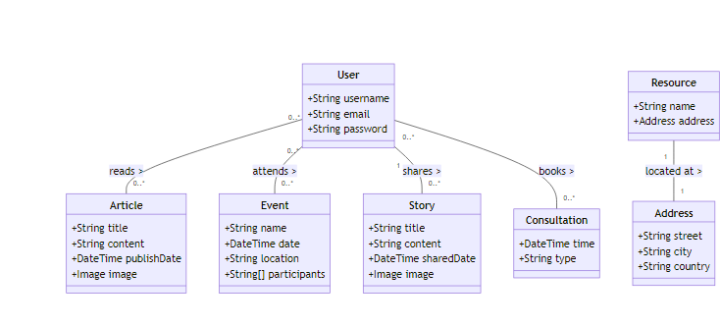
DDD Model

Slide 12
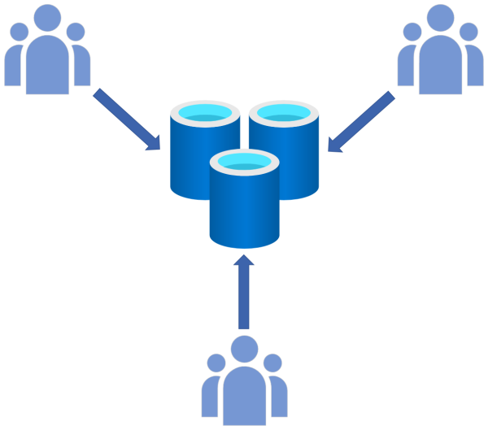
Relationships
Articles and Treatment: Articles can discuss one or more treatments, showing a direct relationship between educational content and specific HIV/AIDS treatments.
Users and Various Entities: Users can interact with multiple entities within the platform:
Read multiple articles.
Share multiple stories.
Attend multiple events.
Resource and Address: Each resource is associated with a specific address, indicating the physical or online location.

Slide 13
04
Project Details

Slide 14

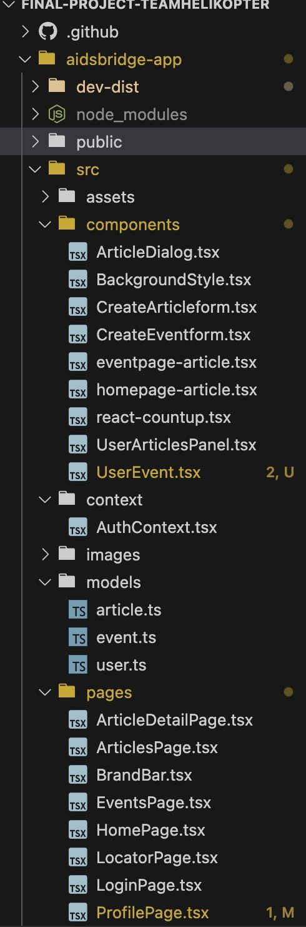
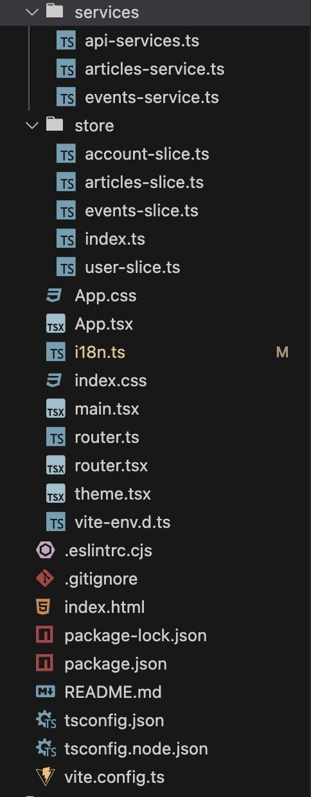

Code Structure
Front-end design
Redux design in front-end to utilize various kinds of functions
Components including buttons, panel, style and etc for ui design
Settings such as theme color, internationalization
Basic model based on DDD model design
Tsx file for each page in the application
PWA

Slide 15

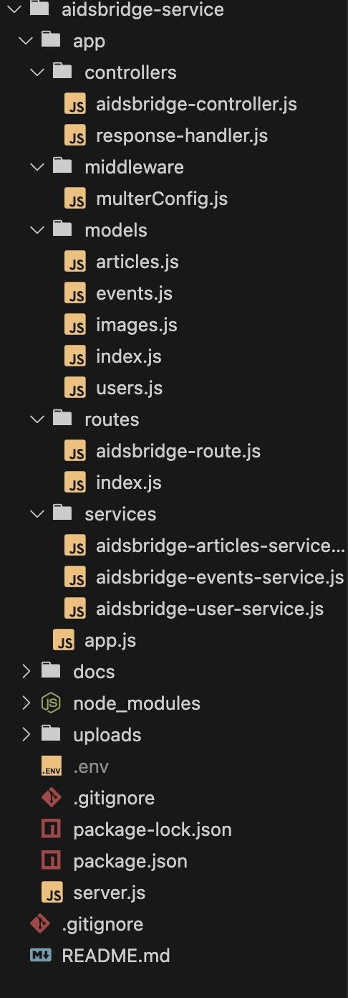
Code Structure
Back-end design
Controllers for processing incoming client requests, managing data validation, and sending responses
REST APIs using Expressjs and Mongo
Services to manage data processing, handle API requests, and ensure secure communication between the user interface and the database,

Slide 16
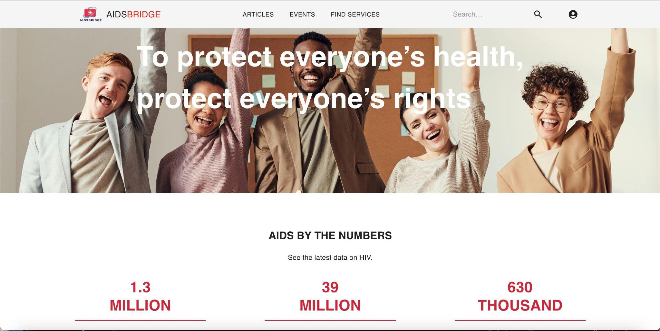
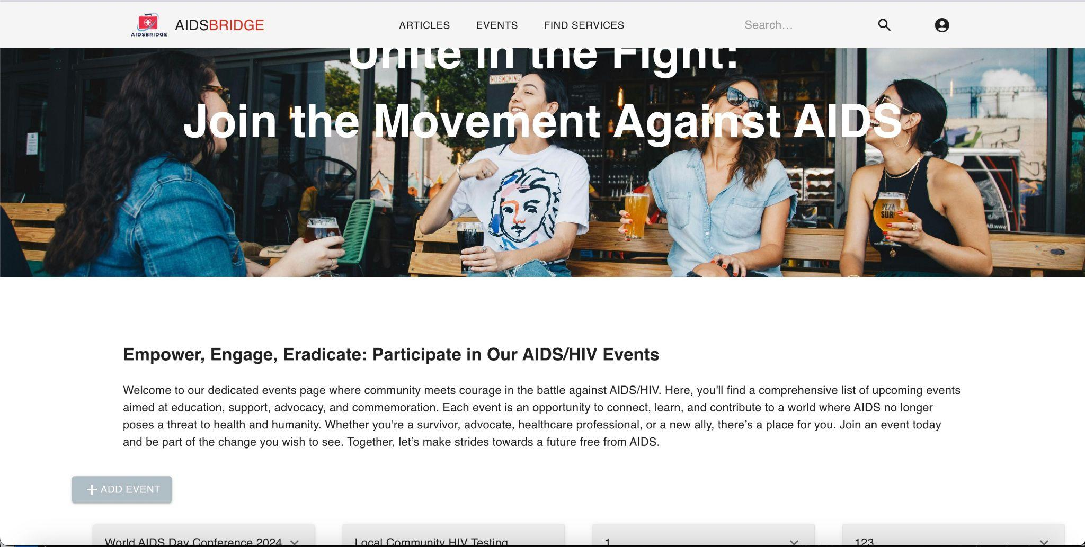
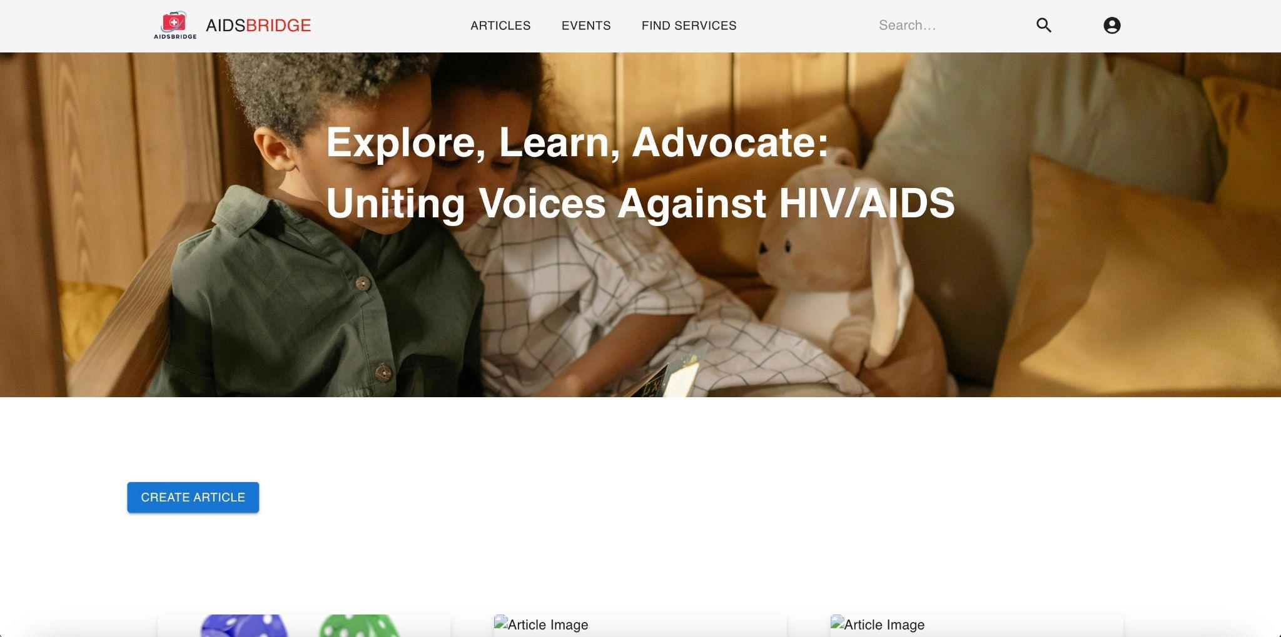
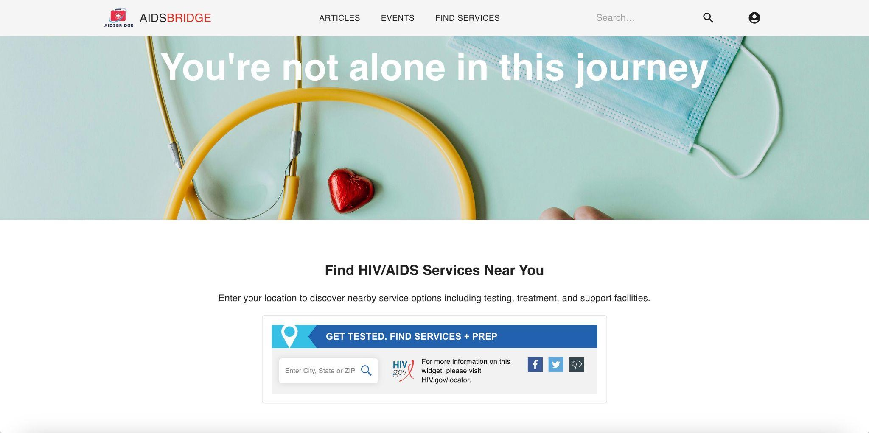
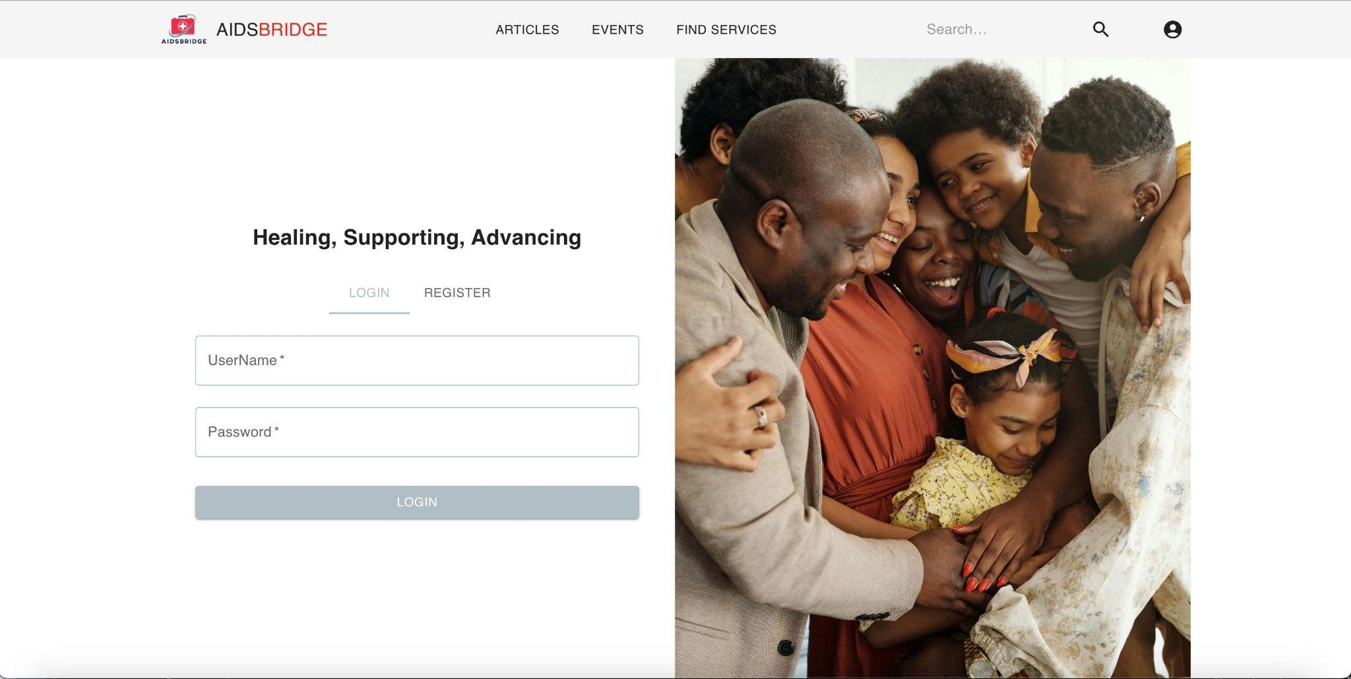
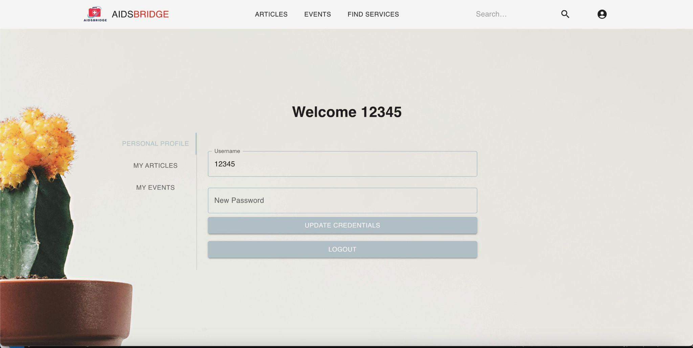
Screenshots
Home Page
Articles Page
Events Page
Locator Page
Login Page
Profile Page

Slide 17



05
Showcase of AidsBridge

Slide 18
06
Conclusion

Slide 19

Conclusion
AIDSBridge successfully delivers a comprehensive digital platform aimed at enhancing access to HIV/AIDS resources. By integrating CRUD operations, Redux for state management, and internationalization, the project ensures a seamless and accessible user experience. Developed as a Progressive Web App and adhering to RESTful API best practices, AIDSBridge combines professional UI design with robust backend functionality to effectively support the global fight against HIV/AIDS. Our Git repository reflects thorough documentation and active contributions from all team members, fulfilling academic and project requirements while addressing a critical global health issue.

Slide 20
THANKS!
Do you have any questions?
Find us on github:
https://github.com/info-6150-spring-2024/final-project-teamhelikopter.git

